Slide 1
Introducing Similarity Relations in a Framework for Modeling Real-world Fuzzy Knowledge
Victor Pablos-Ceruelo
Susana Muñoz-Hernández
susana@fi.upm.es
Universidad Polité́cnica de Madrid, Spain

Slide 2
Outline
Introduction
  Motivation
  Goal
Framework
  FleSe tool
  RFuzzy library
Similarity Constructions
Conclusions

Slide 3
Outline
Introduction
  Motivation
  Goal
Framework
  FleSe tool
  RFuzzy library
Similarity Constructions
Conclusions

Slide 4
Outline
Introduction
  Motivation
  Goal
Framework
  FleSe tool
  RFuzzy library
Similarity Constructions
Conclusions

Slide 5
Available
Crisp data (update and maintenance)
  price, age, temperature, distance, ...
Crisp queries (limited)
  price < 200, temperature > 25, film_type=comedy, … ...

Slide 6
Real World
Crisp data (update and maintenance)
  price, age, temperature, distance, ...
Crisp queries (limited)
  price < 200, temperature > 25, film_type=comedy, …
Fuzzy data (subjective)
  cheap, expensive, fast, warm, cold, …
Fuzzy queries (expressive)
  very cheap, not expensive, quite old, ...

Slide 7
Desirable Fuzziness
Crisp data (update and maintenance)
  price, age, temperature, distance, ...
Crisp queries (limited)
  price < 200, temperature > 25, film_type=comedy, …
Fuzzy world (subjective)
  cheap, expensive, fast, warm, cold, …
Fuzzy queries (expressive)
  very cheap, not expensive, quite old, ...

Slide 8
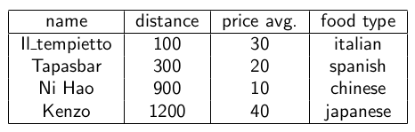
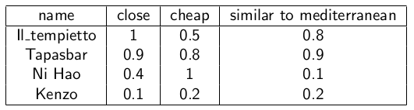
From Crisp till Fuzzy data

Slide 9
Fuzzification of crisp data

Slide 10
Desirable Similarity
Similarity criteria
  alike to Mediterranean food, reddish, ...
the desirable expressive queries (natural at human mind of databases users) includes fuzziness and similarity

Slide 11
Goal
Provide:
Syntax and semantics of similarity constructions to enrich our expressive representation of real-world knowledge
Include similarity criteria in searching queries of our framework to provide constructive answers

Slide 12
Outline
Introduction
  Motivation
  Goal
Framework
  FleSe tool
  RFuzzy library
Similarity Constructions
Conclusions

Slide 13
Outline
Introduction
  Motivation
  Goal
Framework
  FleSe tool
  RFuzzy library
Similarity Constructions
Conclusions

Slide 14
FleSe: Flexible Searches
FleSe is a framework that allows
  database owners
    to define fuzzy search criteria over their data
  database users
    to perform fuzzy queries in traditional crisp databases
FleSe offers
  Web interface
  Parametric database selection
  Personalization of fuzzy search criteria

Slide 15
Technical details
Tomcat server behind an Apache proxy
Prolog database (plain text)
Java interface
Ciao Prolog System (free sw framework)
RFuzzy package (over CLP(R))

Slide 16
Outline
Introduction
  Motivation
  Goal
Framework
  FleSe tool
  RFuzzy library
Similarity Constructions
Conclusions

Slide 17
RFuzzy Library
Over Prolog (distributed computation, constraints, finite domains, ...)
Sugar Syntax (fuzzy functions defs)
Types
Combine crisp and fuzzy information
Incomplete information (default values, conditioned)

Slide 18
Extra expressive features
Modifiers
Negation
Personalized concepts
Overloaded concepts

Slide 19
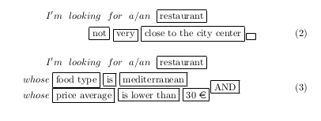
Queries examples

Slide 20

Query syntax

Slide 21
Query elements
individuals (restaurant, film, house, ...)
comparison operands (equal, distinct, greater, less, similar, ...)
fuzzy concepts (big, cheap, close to the beach, ...)
modifiers (quite, rather, much, very, little, ...)
crisp concepts (prize, size, distance, food type, ...)
values (30000, 3, mediterranean, comedy, ...)

Slide 22

Query example with similarity

Slide 23
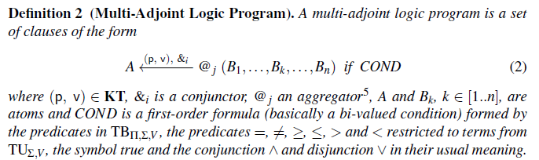
Multi Adjoint Logic

Slide 24

Database Definition

Slide 25

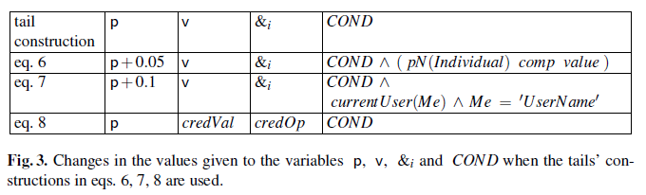
Additional Expressive Constraints

Slide 26
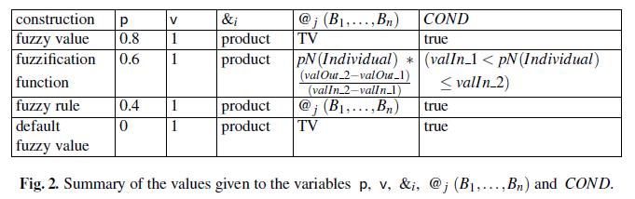
Priorities for Definition Selection
Conditioned similarity
  gorgeous similar beautiful (not men)

Slide 27
Outline
Introduction
  Motivation
  Goal
Framework
  FleSe tool
  RFuzzy library
Similarity Constructions
Conclusions

Slide 28


Similarity Constructions between Attributes

Slide 29

Similarity Constructions between Fuzzy Predicates

Slide 30
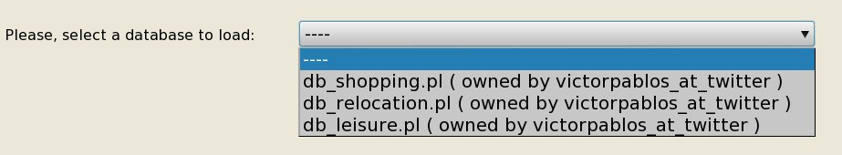
Generic engine

Slide 31
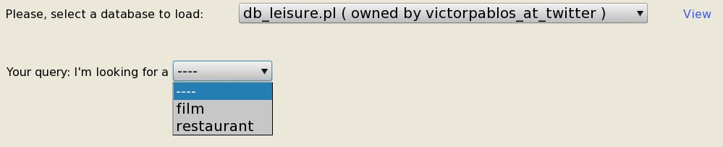
Table selection

Slide 32
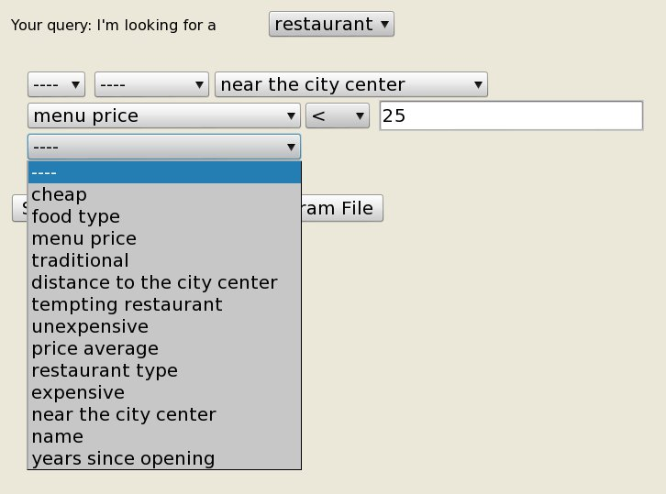
Crisp and Fuzzy concepts

Slide 33
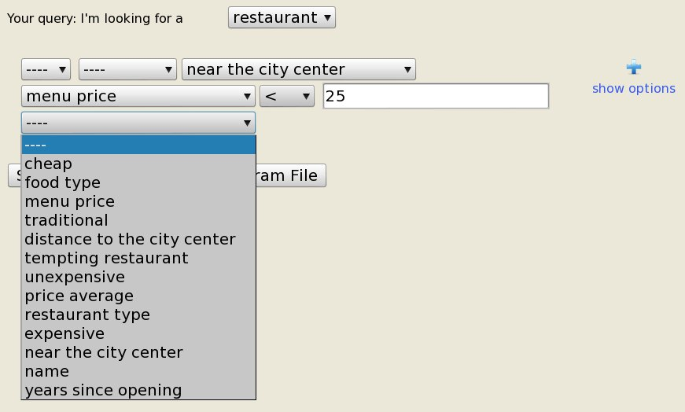
Multi-criteria search

Slide 34
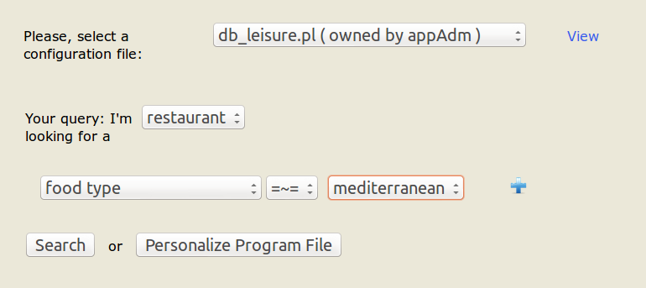
Multi-criteria search

Slide 35
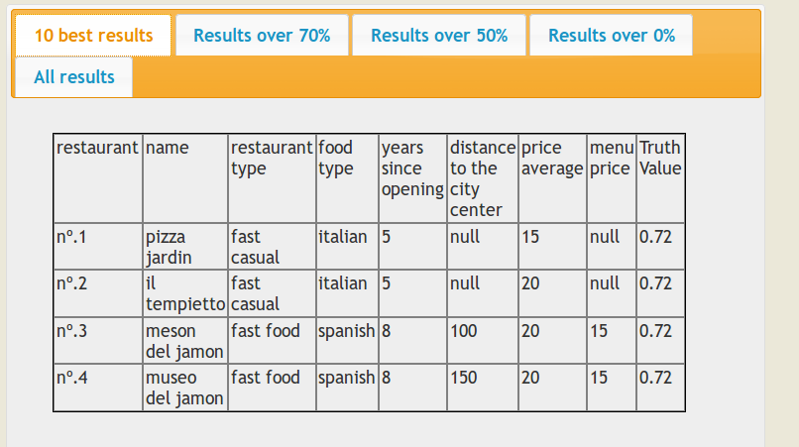
Results

Slide 36
Outline
Introduction
  Motivation
  Goal
Framework
  FleSe tool
  RFuzzy library
Similarity Constructions
Conclusions

Slide 37
Conclusions
We have provided
  Syntax and Semantics of similarity
  Available general constructive framework
  https://moises.ls.fi.upm.es/java-apps/flese/
Serious attempt for feeling the gap to get expressive flexible searches

Slide 38
Introducing Similarity Relations in a Framework for Modeling Real-world Fuzzy Knowledge
Victor Pablos-Ceruelo
Susana Muñoz-Hernández
susana@fi.upm.es
Universidad Polité́cnica de Madrid, Spain

